Slide 1
Speech-to-SPEECH Conversational ai assistant chatbot mentors: Prof. Marios Savvides MAGESH Kannan CMU CyLab Biometrics Center. Research intern: Ayush talukder

Slide 2
About This internship
This project was made as part of an internship with Prof. Marios Savvides at the CMU CyLab Biometrics Center.

Slide 3

overview

Slide 4
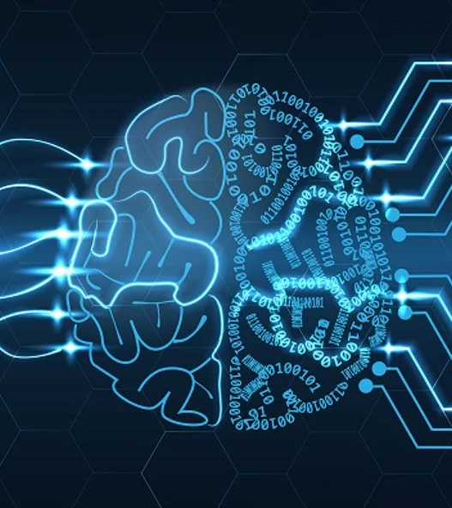
Ai assistant for multilingual speech-based human interaction
This tool would be used to listen to any spoken audio in any language and verbally respond using Llama 3.1 8b to generate a response.

Slide 5




Block chart of algorithm
Arabic response
Audio input
Arabic question asking for a 3-day recommended itinerary
Speech Response
Whisper
GoogleTTS
Llama 3.1 8b
Text to speech
Text response

Slide 6
Multilingual AI SPEECH ASSISTANT Demo (SPANISH)
Spanish Question
Spanish Answer

